Slide 1

NFV Service Development & Operations for the SONATA MANO Platform

Slide 2
2 SONATA-focused sessions on SOFTNETWORKING
SOMA: Presentation-focused project overview = session on Monday afternoon (16:30 - 18:00)
DEMO: hands-on focused SONATA software overview = session on Monday evening (18:40 - 20:30)
a) you are all invited to join and actively participate in the hands-on session!!
b) check https://github.com/sonata-nfv/son-tutorials/ for active participation

Slide 3
SOMA session agenda
SONATA Introduction & overview – Wouter Tavernier
SONATA SDK – Wouter Tavernier
Break (10 min)
SONATA Service Platform – Thomas Soenen
Questions & discussion

Slide 4
SOMA session agenda
SONATA Introduction & overview – Wouter Tavernier
SONATA SDK – Wouter Tavernier
Break (10 min)
SONATA Service Platform – Thomas Soenen
Questions & discussion

Slide 5

Introduction & overview
Dr. Wouter Tavernier
HORIZON 2020

Slide 6





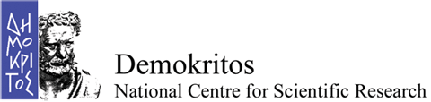








What?
SONATA is an EU-funded project (Horizon 2020) and part of the 5G-PPP initiative
30 month work plan, started in July 2015
15 partners representing telecom operators, manufacturers, system integrators, service providers, SME developers, research and academic institutes
HORIZON 2020

Slide 7

Agenda
SONATA in the context of SDN, NFV & 5G
Objectives & key achievements
DevOps & CI/CD
Architecture
SONATA in the global NFV landscape

Slide 8
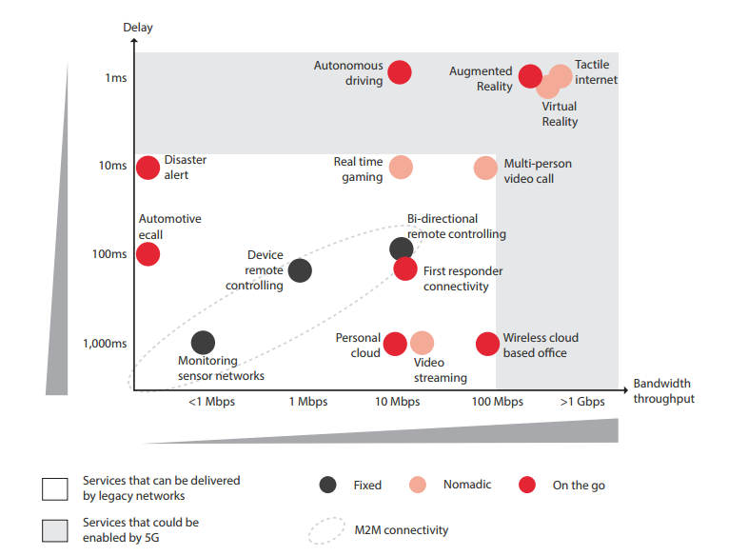
5G as a driver for SONATA
Support of new services that cannot be provided with 4G technologies
Massive & critical IoT, MTC
Ultra low latency, time-critical
Capacity to personalize services for specific applications
Vertical industrial applications
Require resources & provisioning in the entire end-to-end telecom infrastructure
Need for a better way of providing current services
Lower cost, improved performance, improved experience continuity…
Source: GSMA

Slide 9

Industry verticals will adopt E2E 5G technology
Customization towards industry verticals will be key for opportunities:
industry verticals will now be able to offer services directly to their customers
new services, smart scenarios (including mission critical)
new connected products, new market segments
diverse business models among these verticals suggest opportunity for IT partnerships to adapt 5G solutions to their sector, empowering these companies in their own field (as opposed to purely horizontal solutions)
Notes:
Market opportunities are presenting themselves in Automotive (new car to car services), Energy (smart metering systems), eHealth (tele health-care), inmersive Media, SmartCities, etc.

Slide 10

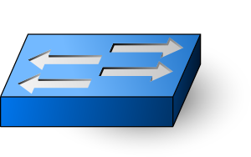






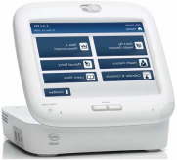


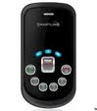
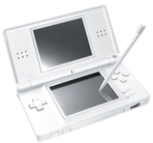

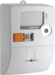


Impact on the E2E telecom infrastructure
Infrastructructure requirements:
Distributed
Multi-tenant
Homogeneous provisioning process
Flexibility enablers:
Software at the control plane (SDN)
Software in the data plane (NFV)
Data Plane must be Distributed
Control Plane can be Centralised
LOCAL PoPs
REGIONAL DATA CENTRES
v
v
CDN (*)
Video (*)
SDP (*)
NGIN (*)
Service Domain
FUNCTION (Software defined)
P-CSCF (*)
Security (*)
IMS (*)
SRVCC (*)
S/PGW (*)
BNG (*)
PE (*)
DHCP (*)
MME (*)
PCRF (*)
Network Domain
DPI (*)
CGNAT (*)
IPv6 Router (*)
DNS (*)
DRA (*)
SPR (*)
HW and SW decoupling
HW and SW decoupling
OS + Hypervisor
OS + Hypervisor
Infrastructure Domain
COTS HW
COTS HW
CAPACITY (Homogeneous infrastructure)
SDN Switching
SDN Switching
Interconnection
Devices
Radio
Places
Fiber
Users
Access
Aggregation
Local Points of Presence
Core
Regional Data Centres
Capillarity, Capacity, Mobility support
Multiplexing
Manage users and sessions, Local managed services
Switching, Transport
Control functions, Regional managed services
Notes:
This gives us 2 questions:
what are the resulting requirements for the infrastructure
what are the enablers to provide this flexibility in service provisioning

Slide 11
What do we actually want?
Service Agility – shorter time for service creation and service adaptation
Service Diversity - a single infrastructure can be used to deploy multiple services with wide range of requirements
Resource Efficiency - Dynamically allocate the right amount of resources when and where needed
source: Ericsson
Notes:
snow ball effect

Slide 12
Agenda
SONATA in the context of SDN, NFV & 5G
Objectives & key achievements
DevOps & CI/CD
Architecture
SONATA in the global NFV landscape

Slide 13

SONATA Objectives
Supporting the transition to software networks
Reducing time-to-market of network services
SONATA’s open source results will support the full service lifecycle, including their development, testing, deployment, management and operations in future SDN/NFV empowered 5G networks.
SONATA streamlines development with abstract programming models, SDK and DevOps workflow that integrates network operators and third-party service developers in an open NFV ecosystem.
Optimising resources and reduce costs of service deployment
SONATA’s platform orchestrates complex services to connectivity, computing and storage resources, and automatically re-configures running services.

Slide 14

SONATA Key Results
1
2
A programming model and Service Development Kit (SDK) that will empower service providers, network equipment vendors and SMEs to develop services based on new or existing network functions, opening the market and reducing time to delivery
3
A set of DevOps tools and methodology that will help connect these stakeholders to a modern, agile workflow that supports the rapid development cycles of software-driven networks, as well as the inter-organizational challenges between them.
An open source service platform with a modular orchestration framework that will help network operators optimize resource utilization, increase automation, reduce OpEx and facilitate their NFV transition
Notes:
DevOps Model: Faster Time T
An “NFV DevOps” model is accelerating the integration of new / updated VNF SW and of new services developed by operators
Moving towards NFV DevOps requires new tooling support for real-time analytics, auto-testing, auto-tuning, continuous integration, o Market

Slide 15
Agenda
SONATA in the context of SDN, NFV & 5G
Objectives
DevOps & CI/CD
Architecture
SONATA in the global NFV landscape

Slide 16
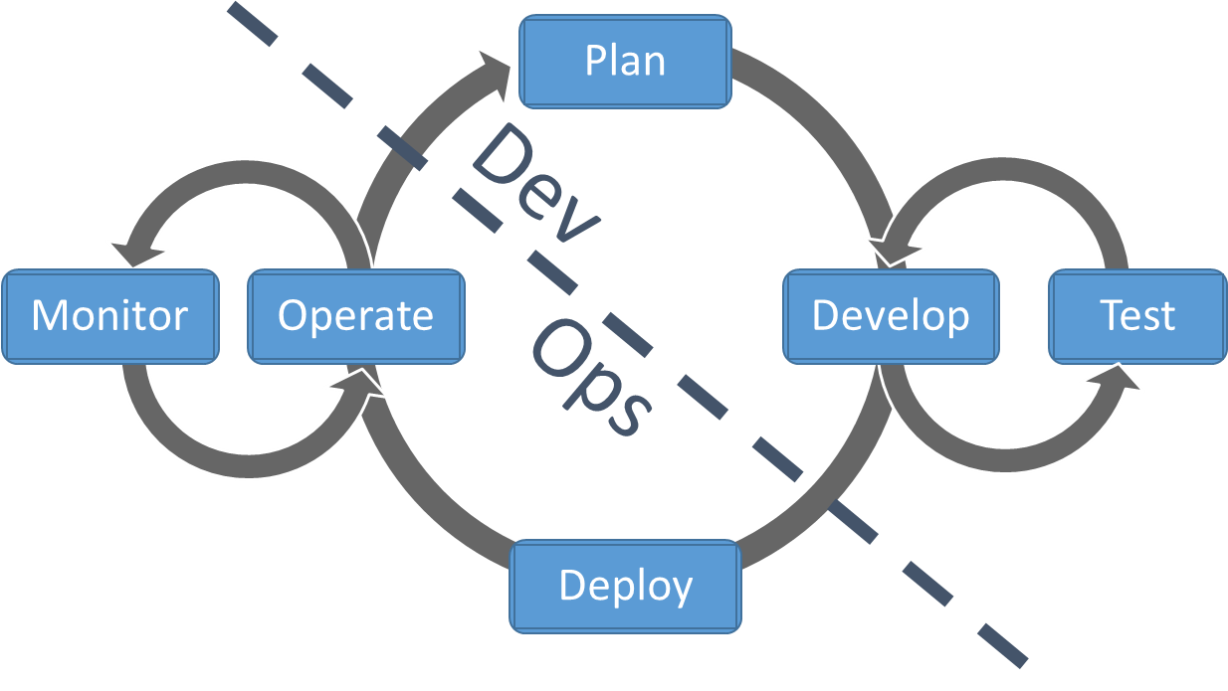
SONATA DevOps
Introducing software industry practices into telco industry
PAST: rigid/dedicated hardware-focused
FUTURE: agile environment where services can be quickly developed, tested and deployed
Continuous integration and deployment (CI/CD) of NFV services
Integrated development and operations (DevOps) of NFV services
Notes:
Thus, we developed an SDK and a Service Platform
DevOps, agile development, and CI/CD is challenging for the telco industry
Technical challenges
- Re-use of artifacts, like VNFs
- Automatic upgrade procedures

Slide 17











CI/CD is taken seriously in SONATA ...
control
pull_req
Github
repositories
Developers
IDEs
Automated actions
download, check dependences,
build & unit test
Bug tracking – to developers
integration test scripts
qualification test scripts
Generate packages
for deployment
v3
Manifesto: Install last versions
a concrete configuration, rebuild
1
v2
Infrastructure
integration
v1
1
Install testable versions
Concrete configuration
v1
Infrastructure
qualification
2PoPs

Slide 18
Agenda
SONATA in the context of SDN, NFV & 5G
Objectives
DevOps & CI/CD
Architecture
SONATA in the global NFV landscape

Slide 19
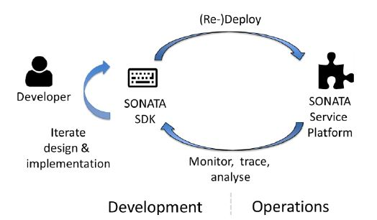
Architecture - a high-level look
SONATA SDK
SONATA Service Platform
Editors
Platform Catalogues
Extended MANO Framework
Repositories
Innovations:
First SDK for NFV
Integrated tools
Emulator
DevOps compliant
Packaging Tool
Debugging & Testing Tools
Innovations:
Modular
Interoperable
Slicing support
Recursive
DevOps compliant
Gatekeeper
Private Catalogues
3. Effective integration of service development (SP) and operations (DevOps) for 5G
VIM
Public Catalogues
Infrastructure
NF
NF
NF
1. Development of virtualized Services and Network Functions
2. Orchestration, deployment and management of virtualized network services
Notes:
The service platform receives the service packages implemented and created with the help of SONATA's SDK and is responsible for placing, deploying, provisioning, scaling, and managing the services on existing cloud infrastructures. It can also provide direct feedback about the deployed services to the SDK, for example, monitoring data about a service or its components.
A specialized NFV DevOps loop connects operator (service platform) and service developer (SDK).

Slide 20
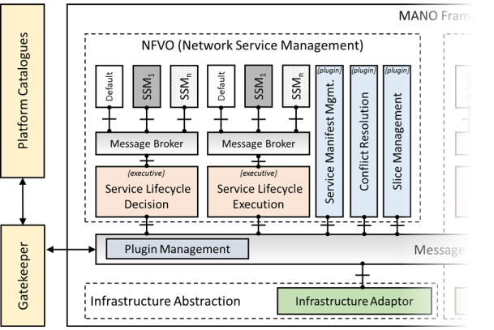
Architecture – recursiveness as a feature
Various ways of recursiveness in SONATA
Recursive descriptors
Allows to include Network Services as VNFs to build an even richer Network Service
Recursive platforms
Run a SONATA SP as an infrustructure for another SONATA SP
Notes:
Recursive descriptors: - Supports the development process of new services

Slide 21
Architecture – Service Platform
2. Responsible for placing, deploying, provisioning, scaling, and managing on existing cloud infrastructure
1. Receives service packages via the GK from the SDK
SONATA Service Platform
Platform Catalogues
Extended MANO Framework
Repositories
NFVO
VNFM
Infra
SSM₁
SSM₂
SSM_{n}
SSM₁
SSM₂
SSM_{n}
SSM₁
SSM₂
SSM_{n}
SSM₁
SSM₂
SSM_{n}
NF
Conflict Resolution
Other Orchestration Plugins
Monitoring Management
Slice Management
Information Management
Conflict Resolution
Service Manifest Management
Message Broker
Message Broker
Message Broker
Message Broker
SONATA SDK
Services
Service Lifecycle Decision
Service Lifecycle Execution
VNF Lifecycle Decision
VNF Lifecycle Execution
Private Catalogues
FSM/SSM
Gatekeeper
Message Broker
Monitoring
Infrastructure Abstraction
Infrastructure Adaptor
VNF Adaptor
Public Catalogues
VIM
Infrastructure
3. Provide direct feedback about deployed service to the SDK, using monitoring components
NF
NF
NF
Notes:
The service platform receives the service packages implemented and created with the help of SONATA's SDK and is responsible for placing, deploying, provisioning, scaling, and managing the services on existing cloud infrastructures. It can also provide direct feedback about the deployed services to the SDK, for example, monitoring data about a service or its components.

Slide 22

Service Platform Architecture – microservices
Micro-service based architecture based on Docker containers
MANO Base
InfluxDB
SSM
SLM
Infra-abstract
Monitoring
RabbitMQ
GUI
Prome-
theus
Catalogs
BSS
Gate- keeper
Notes:
RabbitMQ – an AMQP implementation – is the main communication component
- Well known, and well tested system
- Scaleable, as it can be distributed over multiple servers
- Used also in OpenStack for communication of different components
We have appox. 20 different services running in Docker
- Future step: Use a container management system, like Kubernetes

Slide 23
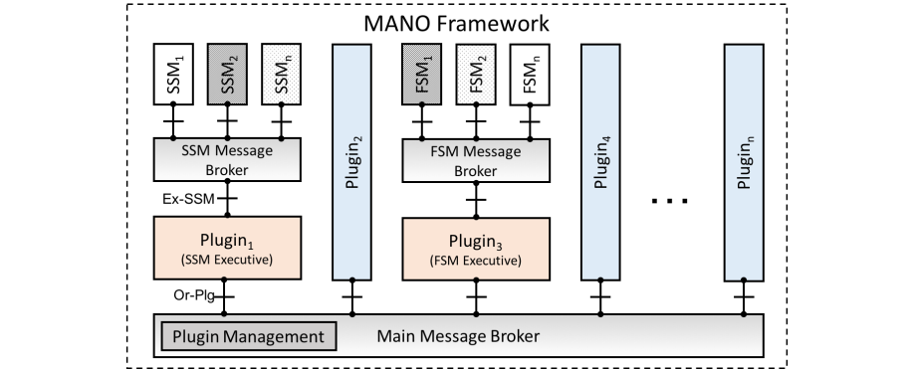
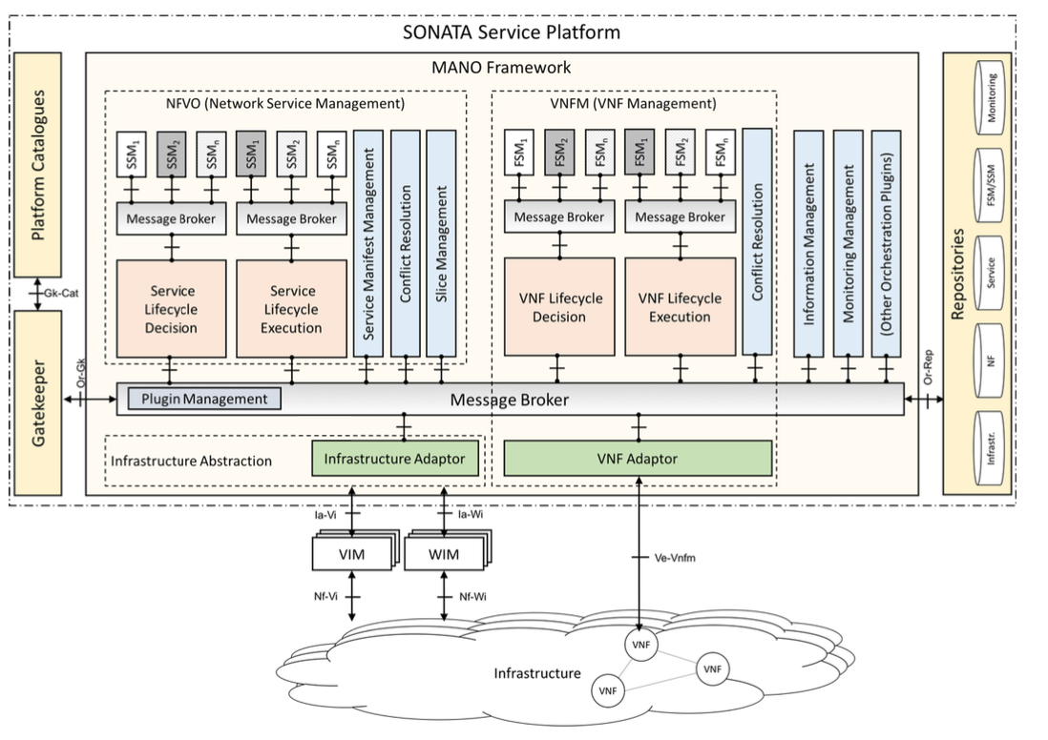
Service Platform Architecture – plugins
The SONATA MANO framework consists of a set of loosely coupled components that use a message broker to communicate
The operator can customize platform functionality or add new features by installing additional plugins
Services can customize the orchestration, management and/or placement logic through FSMs and SSMs

Slide 24
SONATA Architecture - SDK
2. Modify obtained artifacts
5. Debug & test deployed service
SONATA SDK
SONATA Service Platform
Editors
Platform Catalogues
Extended MANO Framework
Repositories
Packaging Tool
Debugging & Testing Tools
Gatekeeper
Monitoring Data Analysis Tools
VIM
Private Catalogues
Infrastructure
NF
NF
NF
1. Obtain & store artifacts into and from cataloges
4. Upload and deploy it on the target platform
Public Catalogues
3. Package the service or NF to prepare it for deployment

Slide 25
Agenda
SONATA in the context of SDN, NFV & 5G
Objectives
DevOps & CI/CD
Architecture
SONATA in the global NFV landscape

Slide 26
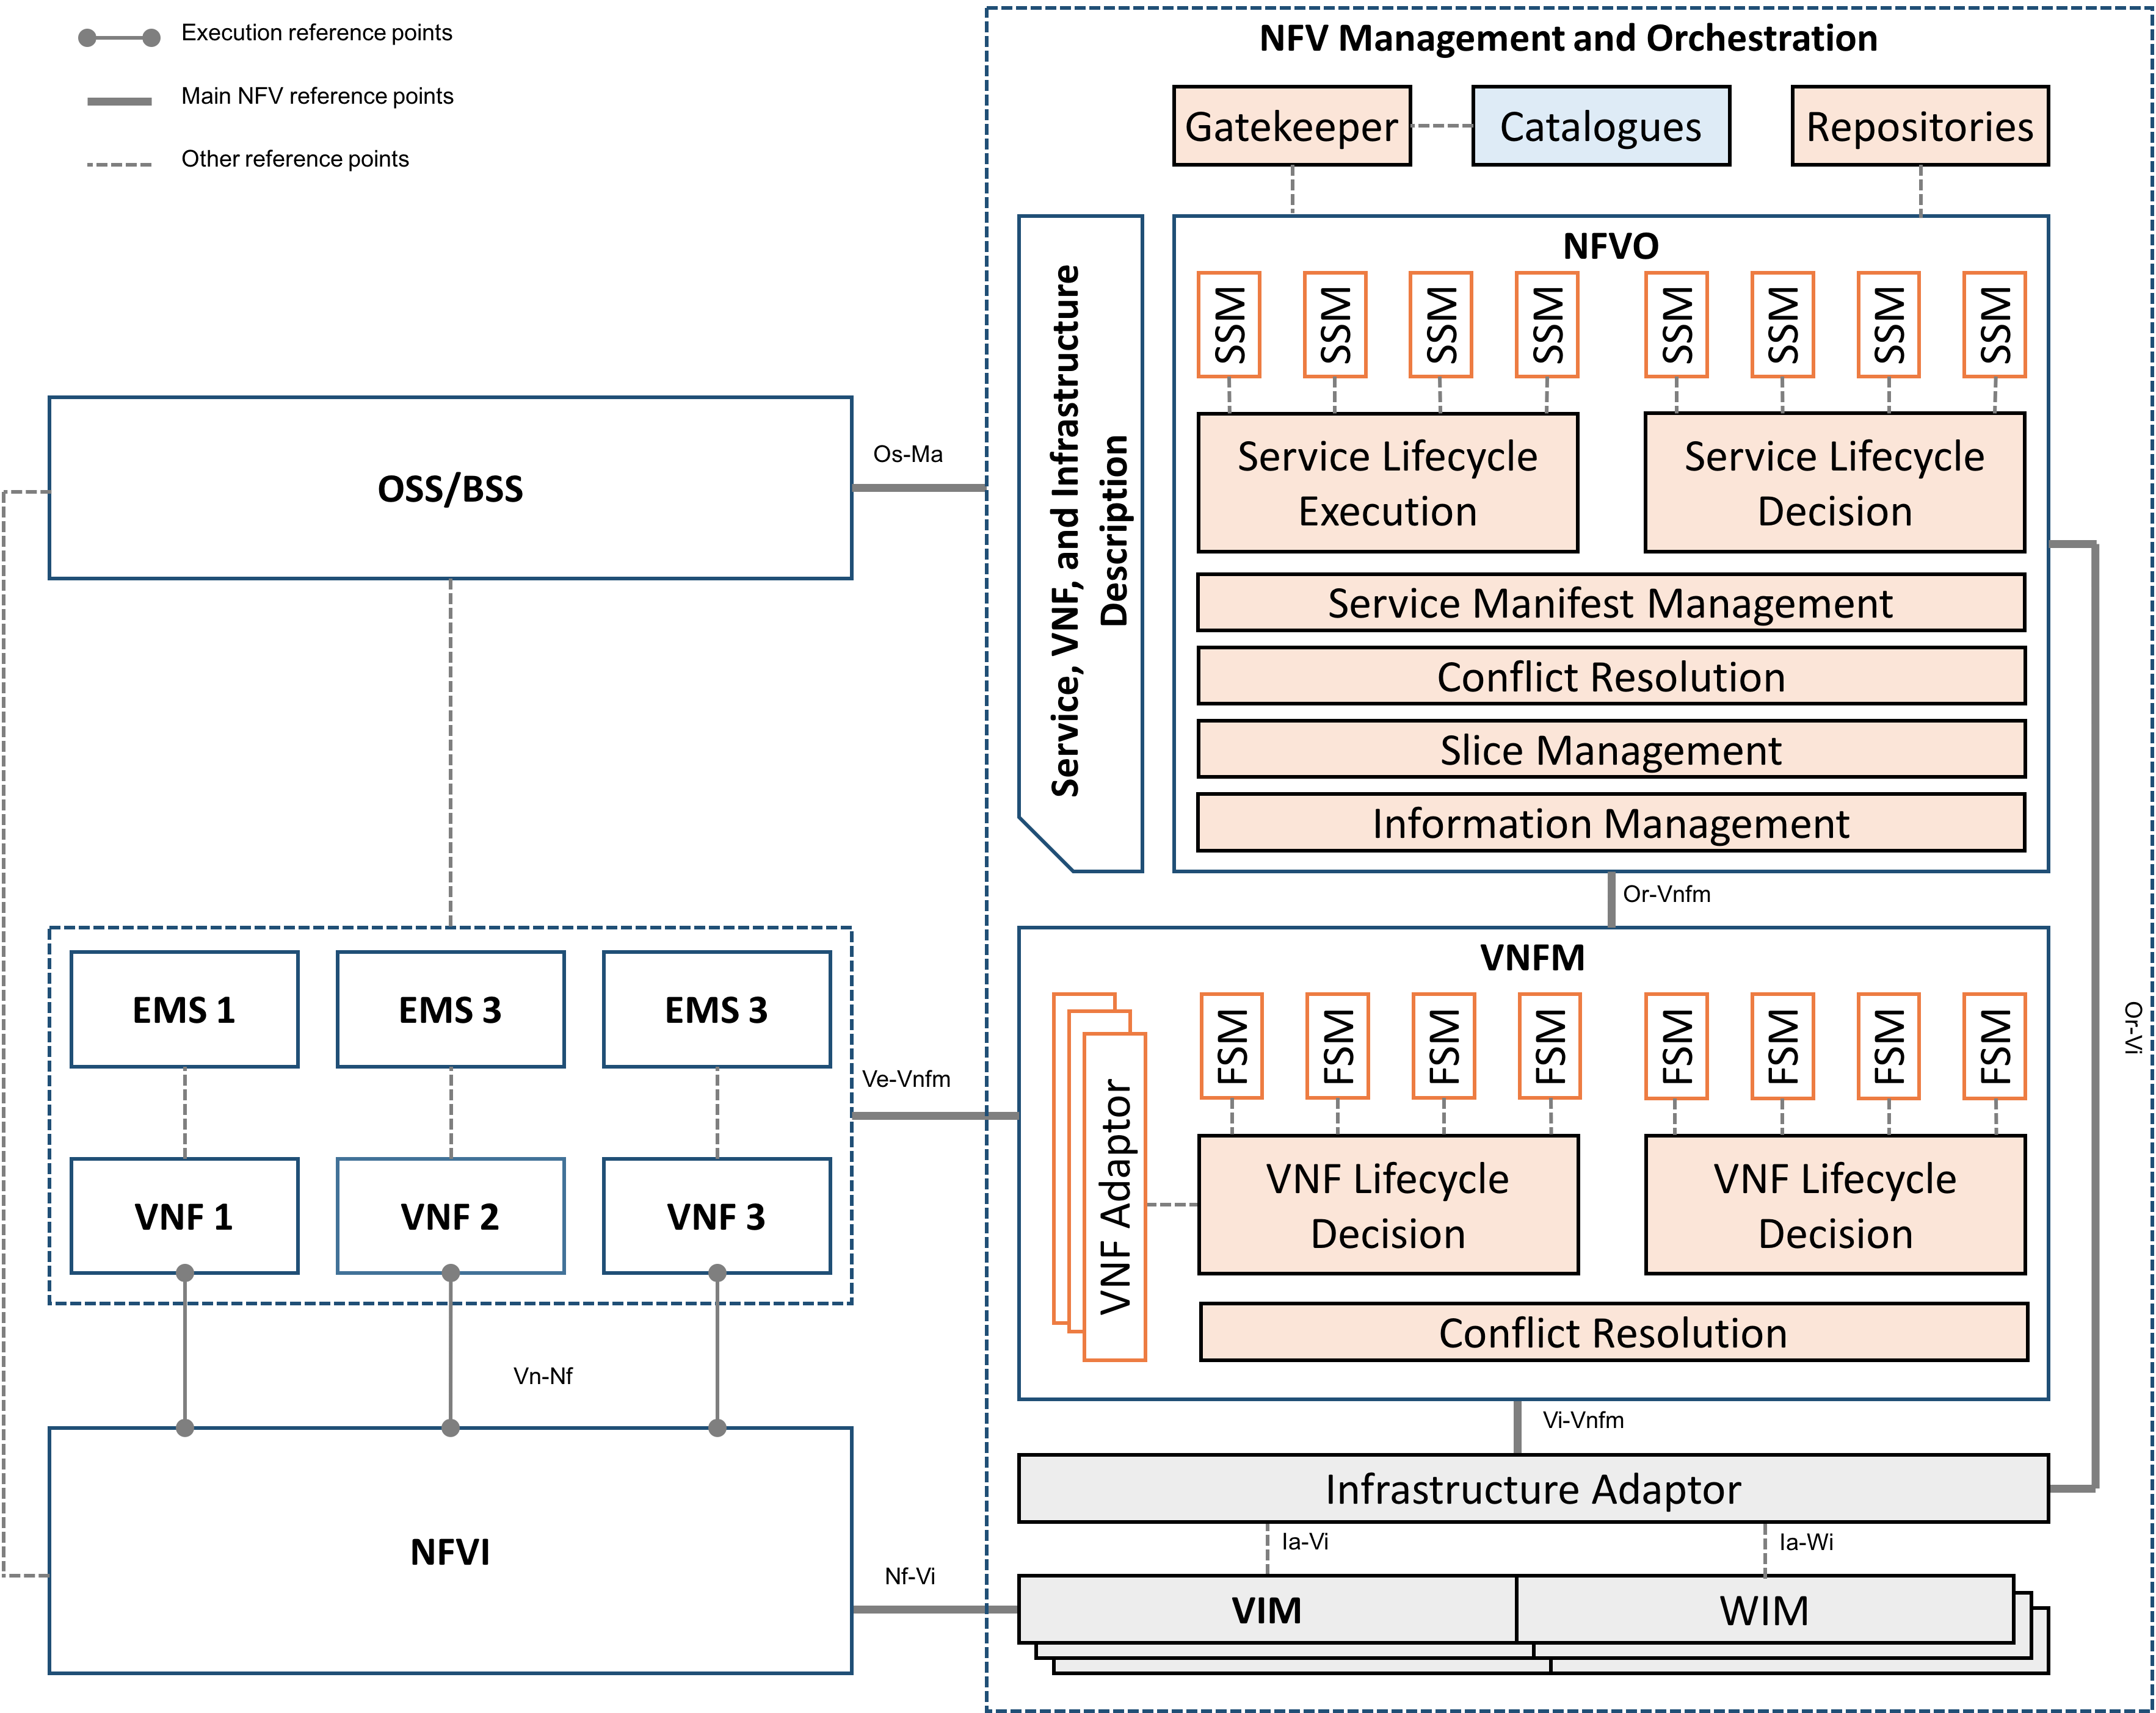
ETSI NFV
Largely compliant with defined ETSI NFV architecture and API
Focus on MANO
Refining NFVO
Introducing GK
Introducing SLM
Refining VNFM into FSM
Implementing multi-VIM/WIM support through Adaptor

Slide 27
SONATA vs. Open Source Mano (OSM)
 | OSM | SONATA
License | Apache 2.0 | Apache 2.0
Descriptor format | YAML, ETSI-compliant | alt. YAML, ETSI-compliant
Packaging support | VNF & NS packaging | VNF & NS packaging
Platform/VIM emulator | - | emulator supporting containers and VMs
Debugging & monitoring | only in infrastructure | in emulator & VIM
Architecture | monolithic | microservice-based
GUI | Juju Charms-based | SDK, BSS, GK GUs
Fine-grained access/user management | multi-user support | multi-user, OAP support, GitHub integration
Multi-VIM support | yes, OpenStack support | yes, emulator and OpenStack support
discussion ongoing towards integrating SONATA components (incl. emulator) into OSM

Slide 28
SONATA vs. other research projects
FP7 UNIFY
PoC-focused research project vs. software-focused innovation project
Resource orchestration vs. service orchestration
Custom YANG programming model vs. ETSI-compliant YAML model
Monolithic orchestrator vs. modular MANO framework
DevOps as a methodology of loosely coupled tools vs. DevOps as integrated E2E closed-loop support of SDK and Service Platform software
FP7 T-NOVA
PoC-focused research project vs. software-focused innovation project
Focus on market place (catalogue) vs. focus on E2E NFV service development and multi-PoP orchestration
Custom YAML programming model vs. ETSI-compliant YAML model

Slide 29
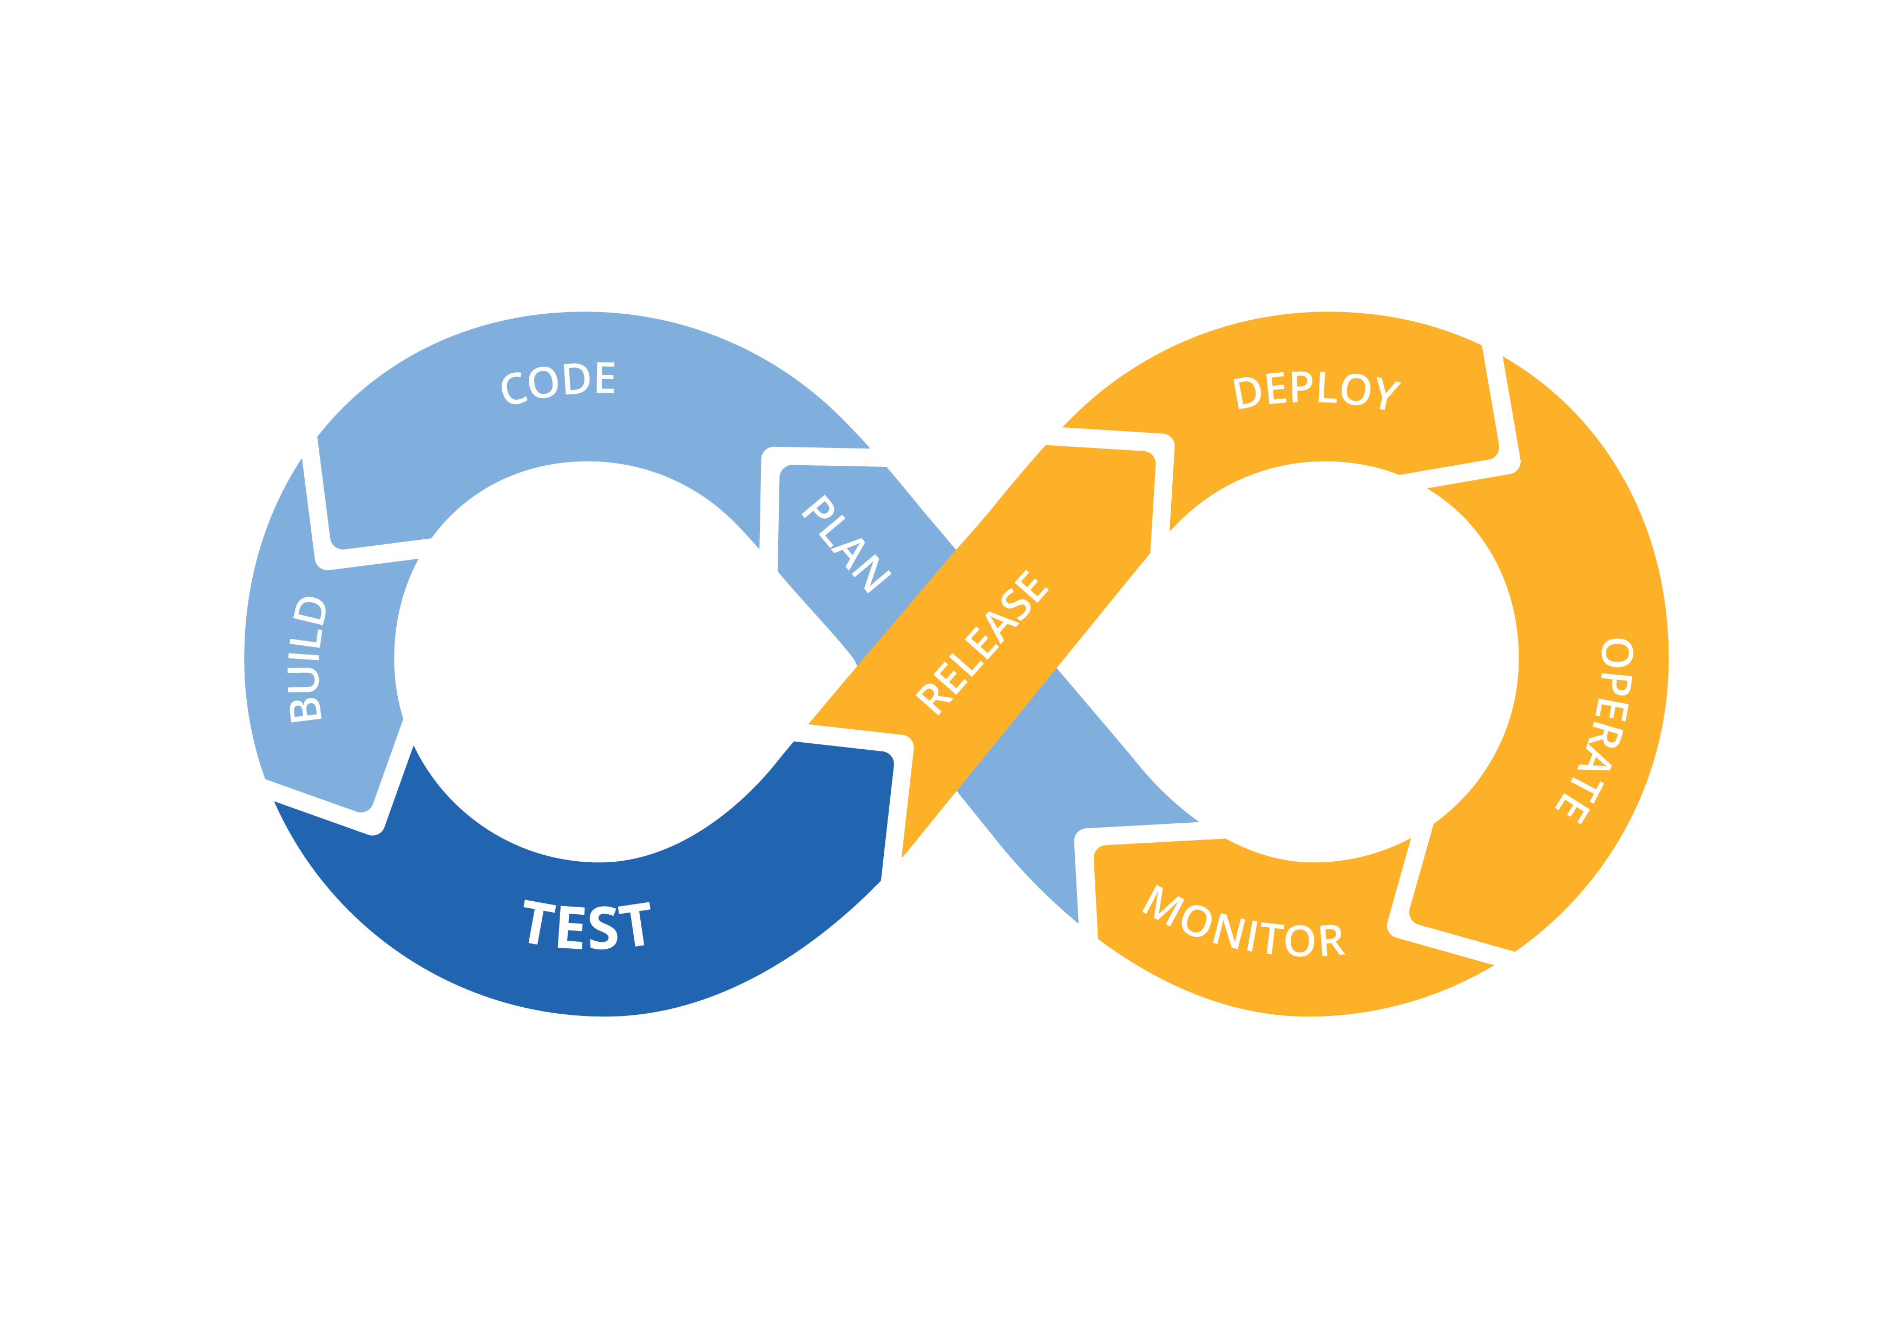
Take aways
SONATA‘s main aim is to reduce the time to market of software-based 5G services through development of:
Software Development Kit for designing & testing NFV services
a microservice-based Service Platform to Manage and Orchestrate service instances over multiple PoPa
a DevOps workflow enabling quick transition between development and operations
SONATA software itself follows a DevOps approach using state-of-the-art CI/CD tools and processes
SONATA builds further on existing research and standardization efforts such as ETSI NFV
Build Continously
Code Continously
Plan Continously
https://github.com/sonata-nfv
Notes:
We did an exhaustive evaluation of use-cases and requirements
Address the picture
- The architecture is not final, it is just the start for the next round ...
Now, elaborate even more on the technical details – and move to WP3 and WP4

Slide 30
backup

Slide 31

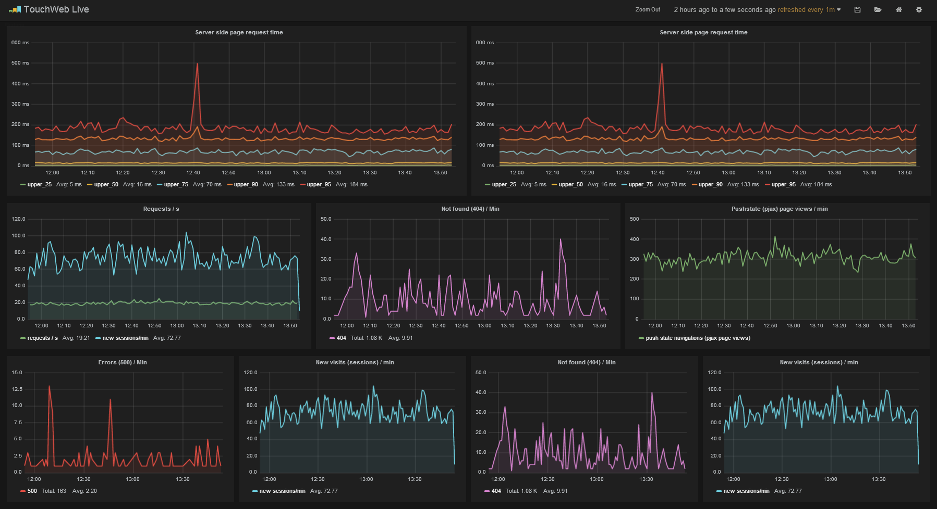
Service Platform Architecture – MANO plugins
The F/SSM concept for platform + service customization
Function Specific Managers (FSM)
Service Specific Managers (SSM)
Control Plane
SSM
FSM
FSM
Data Plane
Network Function
Network Function
Network Service
Notes:
F/SSM concept
- Related to Application Functions (by NEC & DT) in ETSI
The F/SSM connects the VNF/NS with the Service Platform (RabbitMQ)
- From a SP point of view, F/SSM are plugins (executed in Docker containers)
- Both can be used to perform calculations (in addition to the descriptive language in the descriptors, e.g. for monitoring)

